Slide 1


Traze-to-Get-Her
Vaccination Tracker

Slide 2

OBJECTIVE
To develop a reliable, secure and accurate vaccination verification system that provides governments, businesses and other institutions with a single source of truth.
The system will be an upgrade from the existing TraceTogether app, called Traze-To-Get Her.
The system employs the use of blockchain technology to authenticate & endorse COVID-19 vaccination certifications.

Slide 3
Process Flow
01
Government conducts vaccination
Digital vaccination cert given to individual via emai to to his/her Traze-to-Get Mobile application.
Hash of cert with individual details stored on blockchain
Vaccination
02
Individual submits Digital vaccination cert via Traze-to-Get Mobile application.
Document is verified by submitting the Digital cert and individual details via Verification portal
Verification

Slide 4
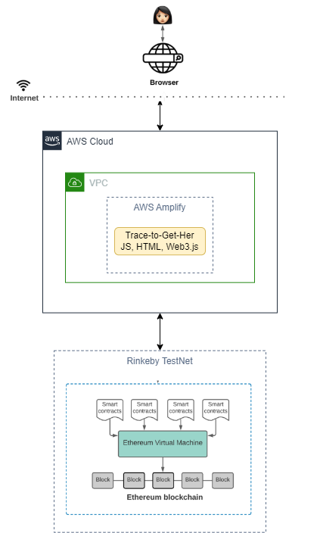
PRODUCTION ENVIRONMENT

Slide 5
UAT/DEVELOPMENT ENVIRONMENT
We will be using local laptop. Here are the list of tools we are using:
REMIX – Testing
Ganache – Local TestNet Simulator
Truffle – Solidity Framework Helper
Programming – Solidity, Node
Visual Code – IDE
RinkeBy – Cloud TestNet Simulator (for production deployment)

Slide 6
DEMO
*Trace-To-Get Her Mobile Application is not shown

Slide 7
QnA

Slide 8
Considerations
Should be a private blockchain operated by the government. Otherwise if stay public, the follow should be considered:
cost is required for every verification/transaction
wallet is required for user
Privacy - Some of the information store on chain could be shifted to off-chain storage.
Technically, an more secure login (like Singpass) should be used for frontend login instead of wallet.

Slide 9
Thank you.

Slide 10
Team mates
Gilbert Zhuo
Goh Yi Fan
Eric See
John Chan
Li Yanmei
Lim Yen-yon

